Slide 1
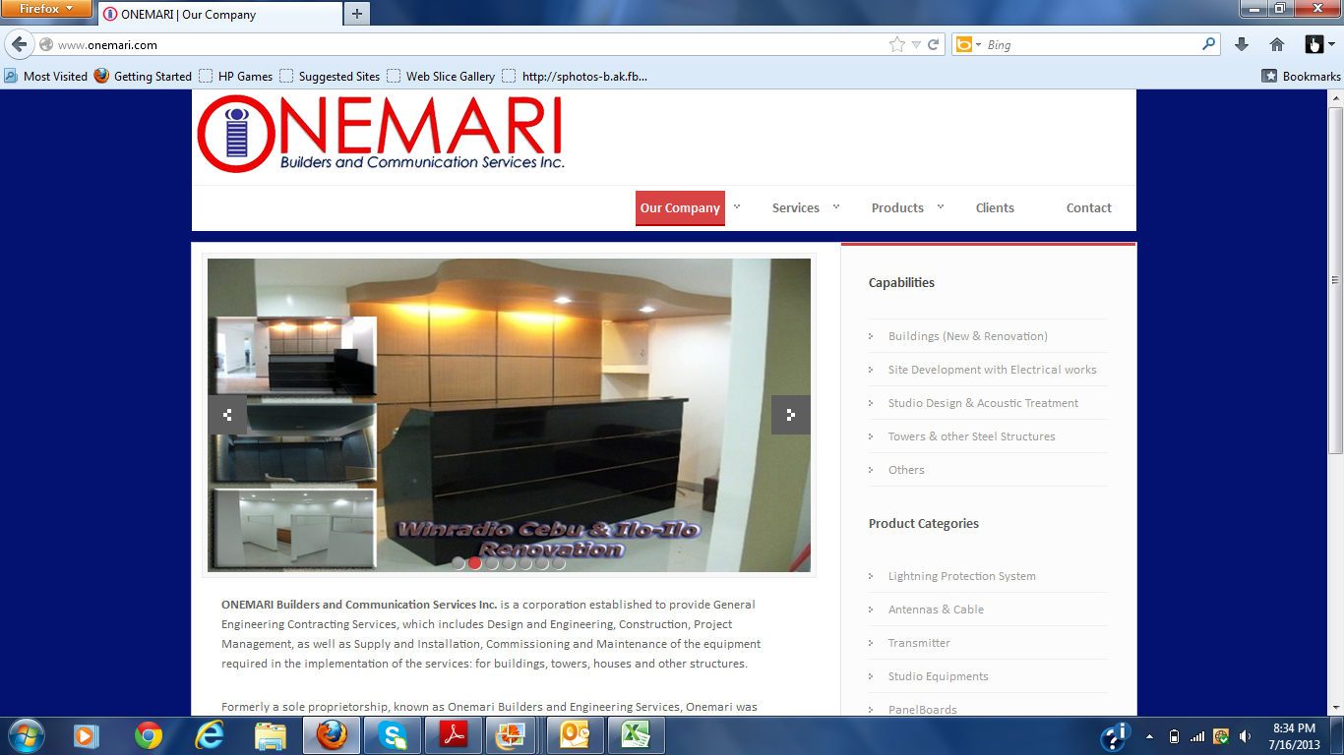
Services
Buildings : Industrial and Offices
Site Development , Electromechanical Works
Towers and other Steel Structures
Studio Design and Acoustic Treatment
Residential
Others
Products
Lightning Protection System
Antennas, Cable and Accessories
Transmitters
Acoustic Treatment
Studio Equipment
Set-up Box

Slide 2
Change to Projects
When you open Projects, what will be shown will be the selected picture of the projects with their details.
There will be two drop down:
Capabilities
Projects List

